Slide 1
TOFINO Spurs Failure: High Epoxy at AT3

Slide 2
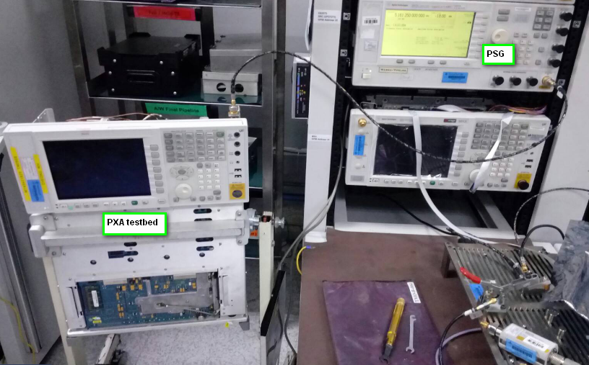
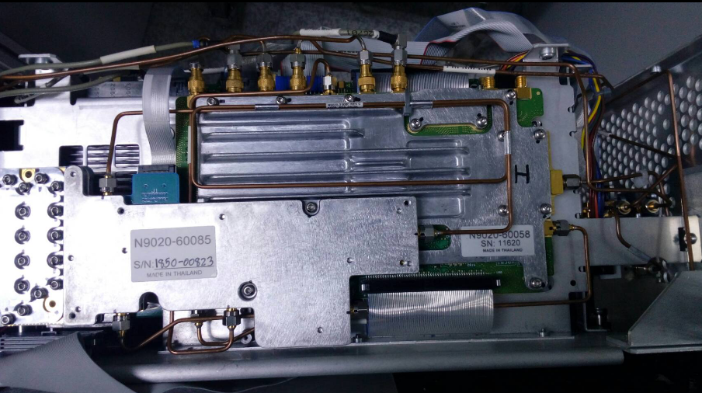
Spurs Subharm Test Method

Slide 3
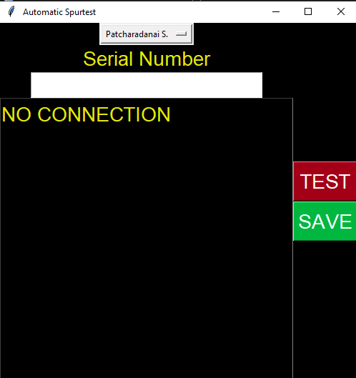
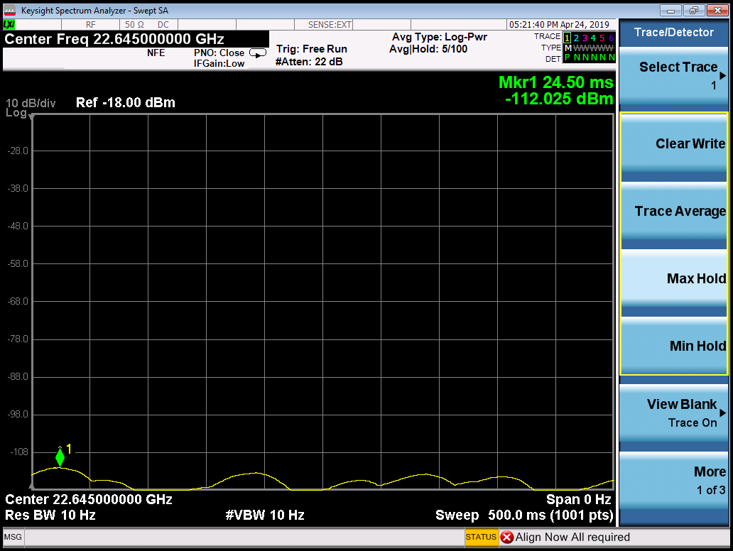

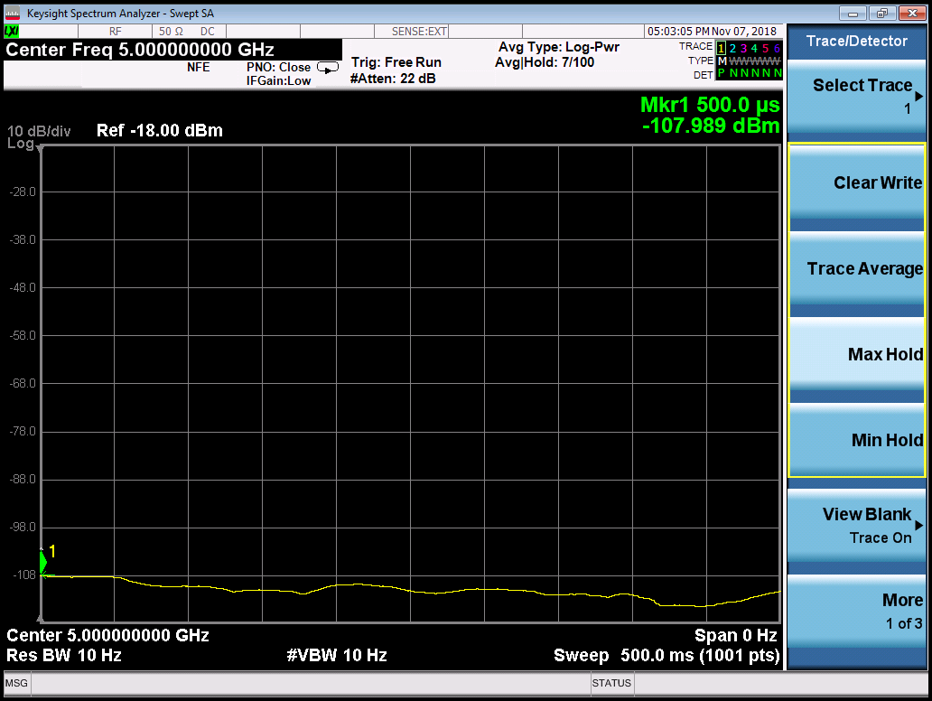
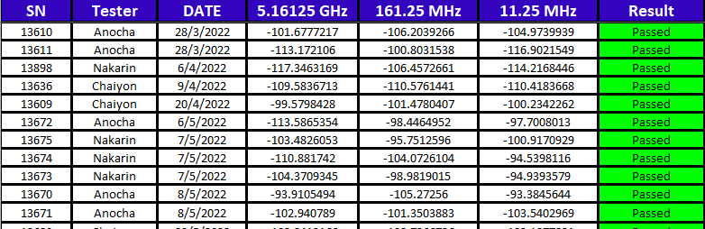

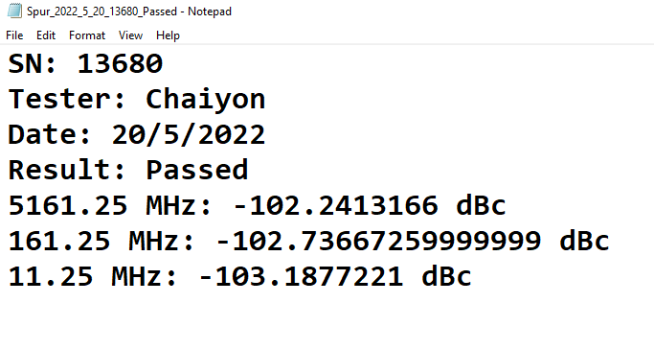
Spurs Subharm Test Method

Slide 4
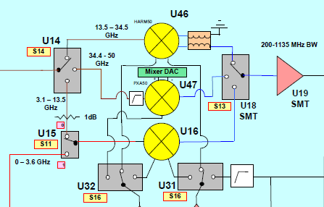
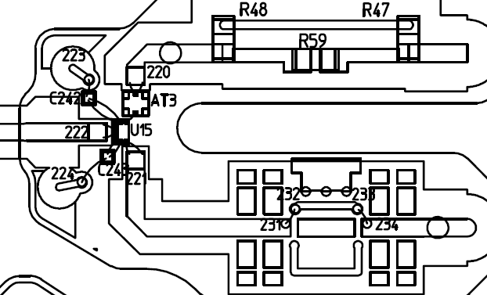
Why AT3?

Slide 5
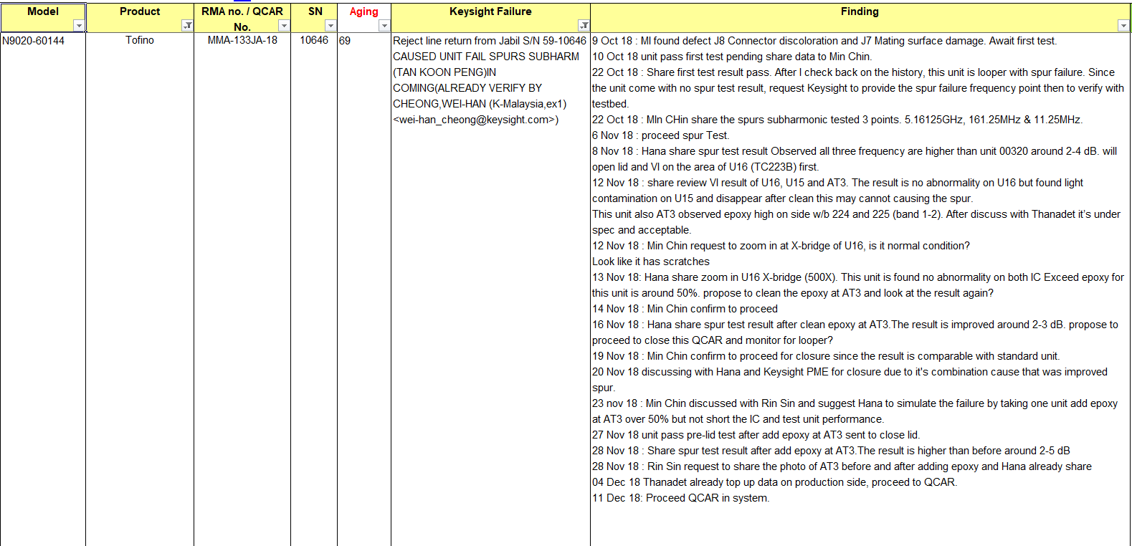
History of Tofino Spurs Failure
- In LRT case year 2018: Found that the unit has high epoxy at AT3. After clean epoxy at AT3 to be 50%, the result is improved around 2-3 dB.

Slide 6
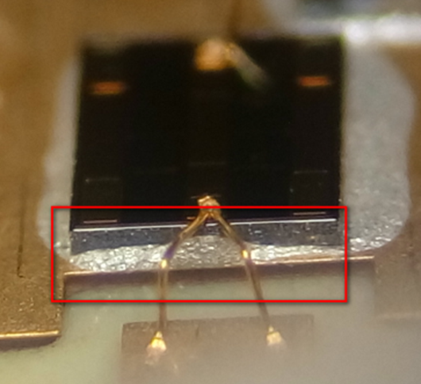
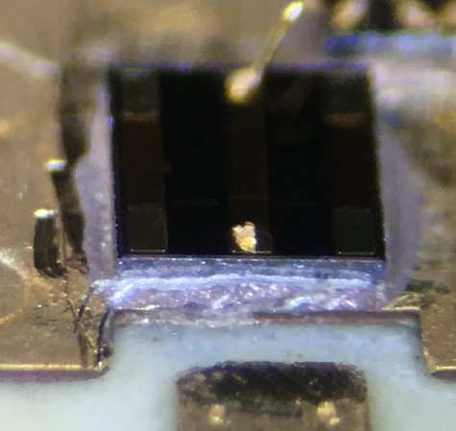
History of Tofino spurs failure: IMAGE
- CASE1:
Epoxy height more than 50% of AT3.
less than 50% of AT3 thickness

Slide 7
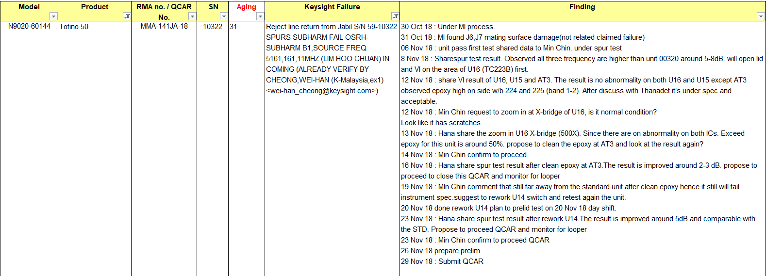
History of Tofino Spurs Failure

Slide 8
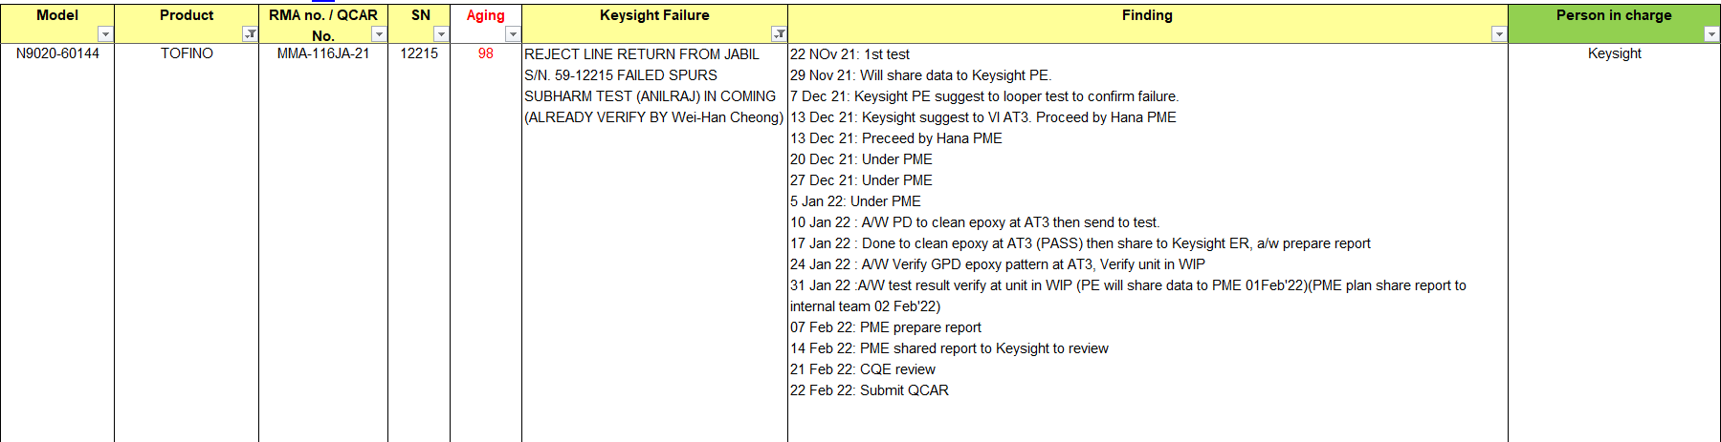
History of Tofino Spurs Failure

Slide 9
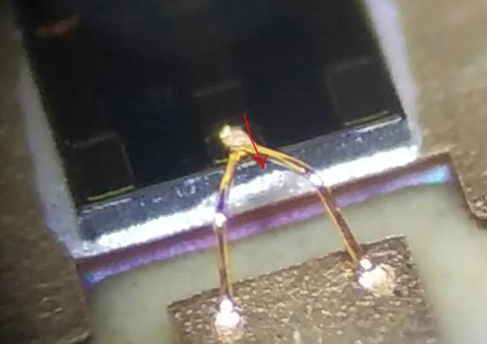
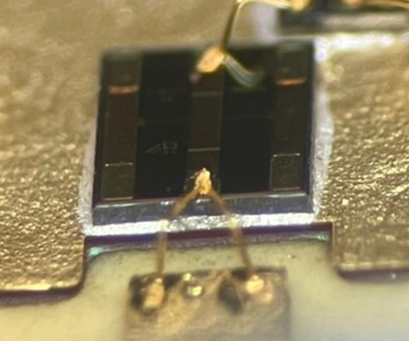
History of Tofino spurs failure: IMAGE
- CASE3:
Epoxy height more than 50% of AT3.
less than 50% of AT3 thickness

Slide 10
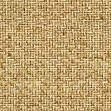


------- THANK YOU -------

